Slide 1
RAD: The Basics
Bennett Hilley, Office of Recapitalization
Will Lavy, Office of Recapitalization

Slide 2
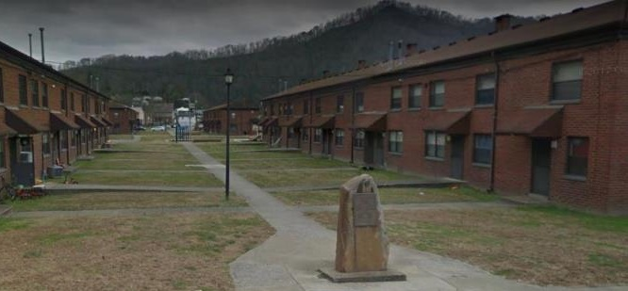
Background
The public housing stock is a critical source of affordable housing for low-income families with children, elderly and persons with disabilities
The aging public housing stock has capital repair and replacement needs that today is estimated to be $50-$75 billion
Between 1995-2012, the public housing stock lost 10,000 homes per year through demolition and disposition
The public housing Capital Fund -- $1.6 -$3.2 billion annually -- has not been funded at levels to address these needs
Notes:
Tom to begin presentation – 10-minute budget

Slide 3
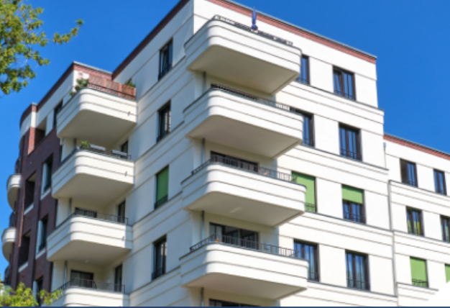
What is RAD?
RAD allows PHAs to convert their Section 9 ACC to a Section 8 Project-based Voucher (PBV) or Project-based Rental Assistance (PBRA) contract. This is a powerful tool to preserve and improve public housing properties.
Notes:
Lots of PHAs are looking at RAD, particularly now,

Slide 4
What is RAD?
RAD for
Public Housing
(1st Component)
Section 8 PBV
(Administered by PHA)
RAD Conversion
RAD for
Multifamily Housing
(2nd Component)
Section 8 PBRA
(Administered by HUD)
Sec. 8 Mod Rehab, Rental Assistance Payment,
McKinney Vento Mod Rehab SRO, Rent Supplement,
Sec. 202 PRAC
Notes:
No need to go into 2nd component in much detail. The main idea: HUD and stakeholders have long acknowledged that shifting affordable housing to project-based Section 8 contracts puts properties on stable funding platform that allows access to recapitalize

Slide 5
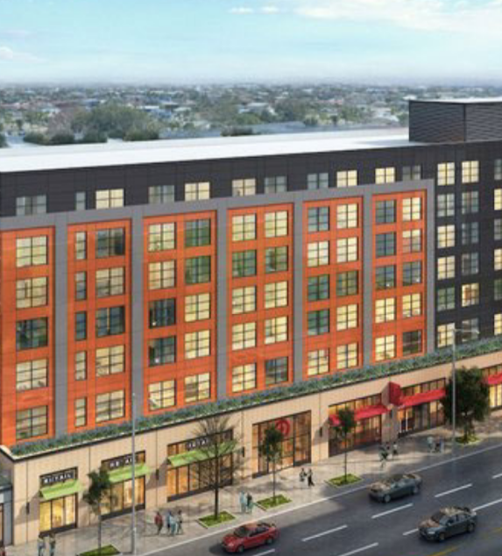
Why RAD?
Address backlog of capital needs to create better living conditions for residents
Access debt and equity to finance improvements
Preserve affordable housing for the long term
Simplify program administration
Protect resident rights
Notes:
Nationwide, many PHAs are very aware of the significant backlog of capital needs in the public housing stock. In 2010, that was estimated to be $26 billion. Most think the actual number these days is $50-$75 billion. Regardless, that pales in comparison to the $3 billion that has been most recently appropriated by Congress (which is even a high water mark). So as an alternative to waiting and hoping for a big capital grant, many PHAs have turned to RAD to address the backlog….

Slide 6
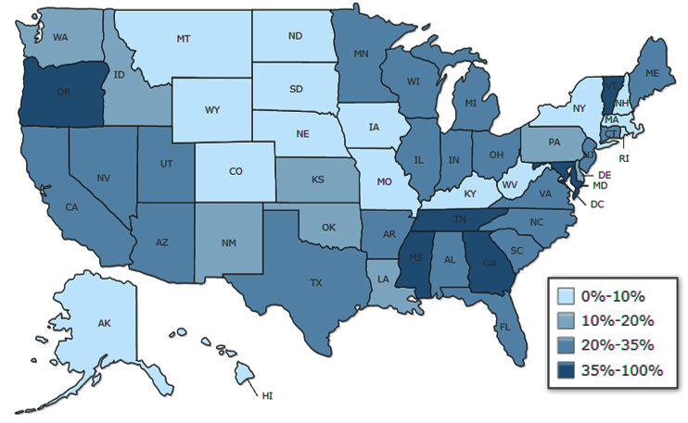
RAD Outcomes
1,500 properties converted (200,000 units)
$15 billion construction investment
$15 in other funds leveraged for every $1 of public housing appropriated funds used
Over 90% of residents remaining in or returning to the property after conversion
Percentage of public housing portfolio that has converted through RAD since 2012

Slide 7
Program Requirements
Notes:
John to begin presenting – 10-minute budget

Slide 8
Contracts and Rents
Predictable Section 8 contract rent
Initial rent setting based on public housing funding levels (soon to be set based on FY 22 levels – high water mark)
Blending with standard Project-Based Vouchers through RAD/Section 18 Blends can supplement property revenue
MTW agencies can supplement the baseline rents
Certain other supplement tools available
Annual rent increases through the operating cost adjustment factor (OCAF)
RAD HAP funding begins at construction closing – “Rehab Assistance Payments”
No limitation on the use of project cash flow

Slide 9
Example: RAD Section 8 “Contract Rents”
Public Housing Funding
Section 8 Contract Rent:
$719 (PUM)
Or higher with flexibilities
9

Slide 10
Project Revenue in a RAD Conversion

Slide 11
Sample Operating Pro Forma
Pro Forma | Per Unit | Project
Contract Rents | $719 | $862,800
Vacancy Loss | ($22) | ($26,400)
Bad Debt Loss | ($14) | ($16,800)
Other Income | $14 | $16,800
Effective Gross Income | $697 | $836,400
Operating Expenses | ($518) | ($621,600)
Replacement Reserve Deposits | ($50) | ($60,000)
Net Operating Income | $128 | $154,800
Hard Debt service | $80
Cash Flow | $48
Soft Debt Service | $24
Example: 100-unit property
Debt Scenario under RAD
At today’s FHA mortgage terms, the property could support $2.4millin ($24k per unit) in debt

Slide 12
Common Financing Sources
1st Mortgage Debt
FHA-insured Debt: 223(f), 221(d)(4)
Conventional Debt
Tax Credits
4% LIHTC
9% LIHTC
Historic Tax Credits
PHA Resources
Operating Reserves
Capital Funds
Demo/Dispo Transition Funding (DDTF)
Sales Proceeds
Other Secondary Financing
HOME
CDBG
Housing Trust Fund
Federal Home Loan Bank AHP

Slide 13
Long-term Preservation and Affordability
Each property must show that is addressing all capital needs
Long-term Section 8 Housing Assistance Payment (HAP) contract renews each time it reaches its expiration.
RAD Use Agreement recorded on the land to further ensure its ongoing affordability. (Replaces the Declaration of Trust)
Property must be owned or controlled by a public or non-profit entity
Public housing assistance must be replaced, with limited exceptions (5% or 5-unit reduction allowed, or more for consolidation of efficiencies or supportive services units)

Slide 14
Ownership Options
Before Conversion
PHA
=
After Conversion
PHA
Instrumentality of the PHA
Non-Profit Affiliate of the PHA
Partnership or Limited Liability Company (LLC)
After conversion, the PHA or a nonprofit must maintain some ownership/control to satisfy RAD requirements.

Slide 15
Conversion Process
Strategic Planning, Initial Application, and CHAP
HUD Review and Issuance of the RAD Conversion Commitment (RCC)
Construction
0-18 months
+/60 days
+/- 90 days
Work called for in the RCC is completed
Resident relocation if necessary to permit the improvements
Resident right to return
Resident opportunities through Section 3
Davis-Bacon wages
What do you want to do with your asset?
Are residents and Board part of the conversation?
Simple RAD application - just the beginning
CHAP provides rent information and confirms eligibility
HUD reviews for long-term physical and financial viability
HUD reviews for long-term preservation and resident protections
Conditional approval of conversion plans
RCC sets out terms of conversion and expected construction
+/- 60 days
6-24 months
Removal from public housing program
Entry into Section 8 Housing Assistance Payments (HAP) Contract and RAD Use Agreement
Residents sign new leases
Due Diligence (capital needs assessment, environmental, etc.)
Up-Front Civil Rights Reviews
Resident consultation
Secure financing commitments
Submit Financing Plan for HUD Review
Financing Plan Development and Submission
Closing and Conversion
Notes:
William to begin presenting – 10-minute budget

Slide 16
Conversion Process
Strategic Planning, Initial Application, and CHAP
+/60 days
What do you want to do with your asset?
Are residents and Board part of the conversation?
Simple RAD application - just the beginning
CHAP provides rent information and confirms eligibility
Notes:
William to begin presenting – 10-minute budget

Slide 17
Conversion Process
Strategic Planning, Initial Application, and CHAP
HUD Review and Issuance of the RAD Conversion Commitment (RCC)
Construction
0-18 months
+/60 days
+/- 90 days
Work called for in the RCC is completed
Resident relocation if necessary to permit the improvements
Resident right to return
Resident opportunities through Section 3
Davis-Bacon wages
What do you want to do with your asset?
Are residents and Board part of the conversation?
Simple RAD application - just the beginning
CHAP provides rent information and confirms eligibility
HUD reviews for long-term physical and financial viability
HUD reviews for long-term preservation and resident protections
Conditional approval of conversion plans
RCC sets out terms of conversion and expected construction
+/- 60 days
6-24 months
Removal from public housing program
Entry into Section 8 Housing Assistance Payments (HAP) Contract and RAD Use Agreement
Residents sign new leases
Due Diligence (capital needs assessment, environmental, etc.)
Up-Front Civil Rights Reviews
Resident consultation
Secure financing commitments
Submit Financing Plan for HUD Review
Financing Plan Development and Submission
Closing and Conversion
Notes:
Commitment to Enter into a Housing Assistance Payments Contract

Slide 18
Strategic Planning, Initial Application, and CHAP
+/60 days
Conversion Process
6-24 months
Due Diligence (capital needs assessment, environmental, etc.)
Up-Front Civil Rights Reviews
Resident consultation
Secure financing commitments
Submit Financing Plan for HUD Review
Financing Plan Development and Submission
Notes:
William to begin presenting – 10-minute budget

Slide 19
Conversion Process
Strategic Planning, Initial Application, and CHAP
HUD Review and Issuance of the RAD Conversion Commitment (RCC)
Construction
0-18 months
+/60 days
+/- 90 days
Work called for in the RCC is completed
Resident relocation if necessary to permit the improvements
Resident right to return
Resident opportunities through Section 3
Davis-Bacon wages
What do you want to do with your asset?
Are residents and Board part of the conversation?
Simple RAD application - just the beginning
CHAP provides rent information and confirms eligibility
HUD reviews for long-term physical and financial viability
HUD reviews for long-term preservation and resident protections
Conditional approval of conversion plans
RCC sets out terms of conversion and expected construction
+/- 60 days
6-24 months
Removal from public housing program
Entry into Section 8 Housing Assistance Payments (HAP) Contract and RAD Use Agreement
Residents sign new leases
Due Diligence (capital needs assessment, environmental, etc.)
Up-Front Civil Rights Reviews
Resident consultation
Secure financing commitments
Submit Financing Plan for HUD Review
Financing Plan Development and Submission
Closing and Conversion
Notes:
William to begin presenting – 10-minute budget

Slide 20
Conversion Process
HUD Review and Issuance of the RAD Conversion Commitment (RCC)
+/- 90 days
HUD reviews for long-term physical and financial viability
HUD reviews for long-term preservation and resident protections
Conditional approval of conversion plans
RCC sets out terms of conversion and expected construction
Construction
0-18 months
Financing Plan Development and Submission
Work called for in the RCC is completed
Resident relocation if necessary to permit the improvements
Resident right to return
Resident opportunities through Section 3
+/- 60 days
Removal from public housing program
Entry into Section 8 Housing Assistance Payments (HAP) Contract and RAD Use Agreement
Residents sign new leases
Closing and Conversion
Notes:
William to begin presenting – 10-minute budget

Slide 21
Conversion Process
Strategic Planning, Initial Application, and CHAP
HUD Review and Issuance of the RAD Conversion Commitment (RCC)
Construction
0-18 months
+/60 days
+/- 90 days
Work called for in the RCC is completed
Resident relocation if necessary to permit the improvements
Resident right to return
Resident opportunities through Section 3
Davis-Bacon wages
What do you want to do with your asset?
Are residents and Board part of the conversation?
Simple RAD application - just the beginning
CHAP provides rent information and confirms eligibility
HUD reviews for long-term physical and financial viability
HUD reviews for long-term preservation and resident protections
Conditional approval of conversion plans
RCC sets out terms of conversion and expected construction
+/- 60 days
6-24 months
Removal from public housing program
Entry into Section 8 Housing Assistance Payments (HAP) Contract and RAD Use Agreement
Residents sign new leases
Due Diligence (capital needs assessment, environmental, etc.)
Up-Front Civil Rights Reviews
Resident consultation
Secure financing commitments
Submit Financing Plan for HUD Review
Financing Plan Development and Submission
Closing and Conversion
Notes:
William to begin presenting – 10-minute budget

Slide 22
Conversion Process
+/- 60 days
Removal from public housing program
Entry into Section 8 Housing Assistance Payments (HAP) Contract and RAD Use Agreement
Residents sign new leases
Closing and Conversion
Notes:
William to begin presenting – 10-minute budget

Slide 23
Conversion Process
Strategic Planning, Initial Application, and CHAP
HUD Review and Issuance of the RAD Conversion Commitment (RCC)
Construction
0-18 months
+/60 days
+/- 90 days
Work called for in the RCC is completed
Resident relocation if necessary to permit the improvements
Resident right to return
Resident opportunities through Section 3
Davis-Bacon wages
What do you want to do with your asset?
Are residents and Board part of the conversation?
Simple RAD application - just the beginning
CHAP provides rent information and confirms eligibility
HUD reviews for long-term physical and financial viability
HUD reviews for long-term preservation and resident protections
Conditional approval of conversion plans
RCC sets out terms of conversion and expected construction
+/- 60 days
6-24 months
Removal from public housing program
Entry into Section 8 Housing Assistance Payments (HAP) Contract and RAD Use Agreement
Residents sign new leases
Due Diligence (capital needs assessment, environmental, etc.)
Up-Front Civil Rights Reviews
Resident consultation
Secure financing commitments
Submit Financing Plan for HUD Review
Financing Plan Development and Submission
Closing and Conversion
Notes:
William to begin presenting – 10-minute budget

Slide 24
Conversion Process
0-18 months
Construction
Work called for in the RCC is completed
Resident relocation if necessary to permit the improvements
Resident right to return
Resident opportunities through Section 3
Davis-Bacon wages
Financing Plan Development and Submission
Notes:
William to begin presenting – 10-minute budget

Slide 25
Conversion Process
Strategic Planning, Initial Application, and CHAP
HUD Review and Issuance of the RAD Conversion Commitment (RCC)
Construction
0-18 months
+/60 days
+/- 90 days
Work called for in the RCC is completed
Resident relocation if necessary to permit the improvements
Resident right to return
Resident opportunities through Section 3
Davis-Bacon wages
What do you want to do with your asset?
Are residents and Board part of the conversation?
Simple RAD application - just the beginning
CHAP provides rent information and confirms eligibility
HUD reviews for long-term physical and financial viability
HUD reviews for long-term preservation and resident protections
Conditional approval of conversion plans
RCC sets out terms of conversion and expected construction
+/- 60 days
6-24 months
Removal from public housing program
Entry into Section 8 Housing Assistance Payments (HAP) Contract and RAD Use Agreement
Residents sign new leases
Due Diligence (capital needs assessment, environmental, etc.)
Up-Front Civil Rights Reviews
Resident consultation
Secure financing commitments
Submit Financing Plan for HUD Review
Financing Plan Development and Submission
Closing and Conversion
Notes:
William to begin presenting – 10-minute budget

Slide 26
Resident Engagement and Rights

Slide 27
Potential Impact on Residents
Continued rental assistance based on 30% of adjusted income
Better living conditions – renovations to improve properties … … but construction is disruptive
Potential changes in utility payments as some PHAs switch from tenant-paid to owner-paid utilities and other PHAs do the reverse
Potential new partners and new people involved
New partners may want a new property management agent (we’ll come back to this)

Slide 28
Consultation Prior to Conversion
Resident meetings required prior to application and periodic additional meetings required following CHAP issuance
Resident notices:
RAD Information Notice (RIN) prior to resident meetings
General Information Notices (GIN) - for URA
RAD conversion is a Significant Amendment to the PHA plan

Slide 29
Relocation and Right of Return
Residents have a right to return post-rehab
Prohibition on re-screening residents upon “move-in” to the Section 8 property
Uniform Relocation Act (URA) applies, and, in some cases, relocation protections are more extensive than URA requirements
No relocation activities can occur until the execution of the RAD Conversion Commitment
Common relocation options include:
On-site
Other public housing
Other affordable housing
Private housing
PHA housing vouchers

Slide 30
Ongoing Rights After Conversion
Residents will pay 30% of adjusted income
A “phase-in” of resident rent is permitted if residents were paying less than 30% of adjusted income prior to conversion
Continued participation in Family Self Sufficiency (FSS), Resident Opportunity for Self Sufficiency, and Jobs Plus, and Earned Income Disregard
Right to maintain and establish a resident organization
Grievance and termination procedures for any adverse action
A right to request a tenant-based voucher after a period of residency at the converted property (“choice-mobility”)
Perpetual affordability of the unit

Slide 31
Key Advanced Tools
Notes:
John to begin presenting – 10-minute budget

Slide 32
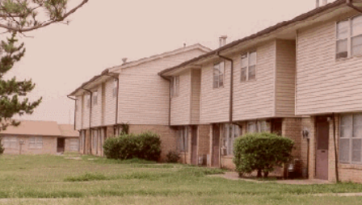
RAD-Section 18 Blends
Section 18 governs disposition (sale) of public housing
Following a Section 18 approval, the PHA may request Tenant Protection Voucher (TPV) funding for units occupied within the last 24 months by assisted families
The PHA may project base (i.e. Project-Based Voucher) the Tenant Protection Voucher funding at the former public housing site to preserve or redevelop the property
What is the advantage of Section 18?
The rental revenue from the project-based voucher may be higher than the rental revenue from the RAD rents
Blending RAD and Section 18 offers access to the best of both tools
Higher contract rents
Robust resident rights
Public housing funds can be used in financing
Integrated review of project viability
The Oklahoma City Housing Authority used a RAD/Section 18 Blend to undertake substantial renovations at Sooner Haven Apartments.
Notes:
79 RAD/Section 18 blends since Oct. 2019 – average construction/rehab cost of $155k per unit

Slide 33
Transfers of Assistance
“Transfer of Assistance” refers to a change in the geographic site of the assistance.
It allows the PHA to improve the location and quality of the housing offered to PHA clients.
TOA can be a key tool in a PHA’s strategy to:
Demolish and redevelop distressed or obsolete properties
Provide rental assistance in better neighborhoods and with access to new opportunities
Thin densities
Mix incomes

Slide 34
Faircloth to RAD
Faircloth
RAD
Faircloth–to–RAD Conversion
Opportunity to create new deeply affordable housing with new rental assistance
Units are developed as public housing
Early RAD commitments facilitate quick conversion to RAD and allow lenders and investors to underwrite the Section 8 contract and rents
Merged and streamlined underwriting and approval process
Once property is developed, it can immediately convert under RAD
HUD provides new subsidy funding to the PHA

Slide 35
MTW Authorities
MTW Agencies can apply many of their MTW program flexibilities to the RAD conversion and to the post-converted RAD units.
Capital – MTW Agencies can use MTW funds as an additional source of capital to support conversion.
Operating – MTW Agencies can augment the conversion’s RAD rents.
MTW funds must be identified in the Financing Plan and the anticipated flexibilities must be referenced in the MTW Plan.

Slide 36
www.hud.gov/rad
Email questions to
rad@hud.gov
We’re here to help!

Slide 37
Appendices

Slide 38
Project Based Vouchers (PBV) vs.
Project Based Rental Assisance (PBRA)
 | Project-based Vouchers (PBV) | Project-based Rental Assistance (PBRA)
Appropriations Account | “Tenant-Based Rental Assistance” account | “Project-Based Rental Assistance” account
Contract Administrator | PHA (component of PHA’s Housing Choice Voucher program) with PIH oversight. Added to PHA’s Housing Choice Voucher program w/ admin fees | HUD Multifamily (OAMPO oversight)
Contract Term | Initial contract term of 15-20 years, must renew. | Initial contract term of 20 years, must renew. Renews under “MAHRA”
Inspection Type | Housing Quality Standards by PHA or Independent Entity | Uniform Physical Condition Standards (UPCS) by REAC
“Choice Mobility” | Residents have option to move with a tenant-based voucher after one year | Residents have option to move with a tenant-based voucher after two years. PHA and owner can adopt some limitations
Rent Caps | Rent Caps – Lower of current funding, reasonable rent, 110% FMR minus utilities | Rent Caps – Lower of current funding and 120% FMR minus utilities (except with Rent Comparability Study)
Other | PBV competitive selection, income-mixing, and PBV program cap requirements do not apply

Slide 39
Key Resources
RAD Statute
RAD Implementation Notice, Revision 4: H 2019-09, PIH 2019-23
Fair Housing, Civil Rights and Relocation Notice: H 2016-17 PIH 2016-17
Guides and FAQs (www.radresource.net)
RAD Inventory Assessment Tool

Slide 40
RAD / Section Blends

Slide 41
Two Types of Blends
Construction Blends – Based on proposed construction costs for new construction or rehabilitation relative to HUD-published “Hard Construction Cost” thresholds
Small PHA Blends – For PHAs with 250 or fewer public housing units
Up to 80% of the units may be disposed of under Section 18, but PHA must have a plan to recapitalize and convert all of its public housing units
Required HCC Threshold | RAD / Section 18 Blend Percentage
>30% | 80% RAD / 20% Section 18
>60% | 60% RAD / 40% Section 18
>90% | 40% RAD / 60% Section 18
>90% + in high-cost area (Local HCC > 120% of national average HCC) | 20% RAD / 80% Section 18

Slide 42
Construction Blends
Example:
100-unit elderly building in East Baton Rouge
RAD Rents are approximately 86% of FMR
Construction Costs per Unit | RAD/Section 18 Construction Blend | Average Contract Rents (Estimate)*
<$31k (less than 30% of HCC) | 100% RAD | $650
Between $31k and $62k (between 30-60% of HCC) | 80% RAD / 20% Section 18 | $692
Between $62k and $92k (between 60-90% of HCC) | 60% RAD/40% Section 18 | $730
More than $92k or new construction (more than 90% of HCC) | 40% RAD/ 60% Section 18 | $776
*Assumes RAD rents set at $650 and PBV rents set at 110% of FMR
Notes:
Note to Will – I used the figures you showed me, inflated to the 2022 OCAF and used 110% of the 2022 FMR for East Baton Rouge.

Slide 43
Sample Pro Forma
Example:
100-unit East Baton Rouge property
Debt Scenario under RAD
At today’s FHA mortgage terms, the property could support $2.4 million ($24k per unit) in debt
Pro Forma | Per Unit | Project
Potential Rents | $650 | $780,000
Vacancy Loss | ($20) | ($23,400)
Bad Debt Loss | ($13) | ($15,600)
Other Income | $13 | $15,600
Effective Gross Income | $631 | $756,600
Operating Expenses | ($451) | ($541,200)
Replacement Reserve Deposits | ($50) | ($60,000)
Net Operating Income | $130 | $155,400
Debt Scenario with a RAD/Section 18 Blend
If the property completes over $31k per unit in rehab it is eligible for a RAD/Section 18 blend
At increased revenue under the blend, it could support $3.2 million ($32k per unit) in debt

Slide 44
Faircloth

Slide 45
Faircloth to RAD Pipeline
Non-MTW Agencies
Albany Housing Authority (NY)
Dover Housing Authority (DE)
Eloy Housing Authority (AZ)
Highlands Residential Services (TN)
Housing Authority of Prince Georges County (MD)
Housing Authority of Shreveport (LA)
Housing Authority of the City & County of San Francisco (CA)
Housing Authority of the City of Alameda (CA)*
Housing Authority of the City of Camden (NJ)
Housing Authority of the City of Fresno (CA)
Housing Authority of the City of Gainesville (GA)
Housing Authority of the City of Galveston (TX)
Housing Authority of the City of Los Angeles (CA)
Manhattan Housing Authority (KS)
Miami-Dade County (FL)
Murfreesboro Housing Authority (TN)
Newark Housing Authority (NJ)
South Lyon Housing Commission (MI)
The Housing Authority of City of East St. Louis (IL)
The Housing Authority of the City of Atlanta (GA)
Total Count
PHAs | Projects | Units
28 | 45 | 2,744
Participating MTW Agencies
Cambridge Housing Authority (MA)
Chicago Housing Authority (IL)
District of Columbia Housing Authority
Housing Authority of Baltimore City (MD)*
Philadelphia Housing Authority (PA)
Housing Authority of the City of New Haven (CT)
Housing Authority of the City of Vancouver (WA)
Washington County (MN)

Slide 46
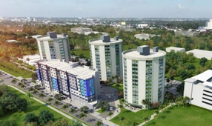
Projects Underway
Galveston — Oleanders at Broadway
174 new construction F2R units in mixed-income 348-unit property.
Part of a 706-unit strategy to replace 569 public housing units destroyed by Hurricane Ike in 2008. Only the 26-unit scattered site development is outstanding.
Miami-Dade — Brisas del Este Apartments
30 new construction units in mixed-income 161-unit building on excess public housing land.
All units with similar design, amenities including fitness center, multi-purpose rooms, work lounge, pool room, domino room, community kitchen and laundry room on each floor
Washington, DC — Kenilworth 166
101 new construction Faircloth-to-RAD units in larger 166-unit senior/family affordable housing development. First phase of 530-home initiative.
Includes mix of 4-story elevator buildings, townhomes and stacked flat apartments
Amenities include fitness room, community room and tuck-under parking

Slide 47
Faircloth to RAD Strategies
Current pipeline is using Faircloth-to-RAD to…
Construct new affordable housing through a PHA-affiliated entity
Construct new affordable housing in partnership with a third-party developer
Acquire existing properties with rehab
Place assistance in existing properties in response to Requests for Proposals (RFPs) (provided the property satisfies RAD ownership & control requirements)
Emerging pipeline is using Faircloth-to-RAD to…
Acquire existing properties without rehab
Add new affordable units to the RAD conversion of an existing public housing property
Key question is mixed-finance vs. not mixed-finance
Currently, F2R is designed around the mixed-financing public housing development processes

Slide 48
Faircloth to RAD Process

Slide 49
Transfer of Assistance

Slide 50
How can transfer of assistance be used?
Example 1: PHA has a public housing property in a blighted area. Preservation or redevelopment on-site does not meet local housing goals, but the PHA wants to replace with “hard” affordable units. The PHA transfers all the units to a single new site in a different community.
50-unit public housing property
50 RAD units in a new 50-unit property

Slide 51
How can transfer of assistance be used?
Example 2: PHA has a large public housing property in a blighted area. Preservation or redevelopment on-site does not meet local housing goals, but the PHA wants to replace with “hard” affordable units. The PHA transfers units to five alternative sites.
25 RAD units in a new 25-unit property
25 RAD units in an existing 50-unit property
200-unit public housing property
25 RAD units in an existing 150-unit property
100 RAD units in a new 100-unit property
25 RAD units in a new 100-unit property

Slide 52
How can transfer of assistance be used?
Example 3: PHA has a public housing property that it wants to preserve or redevelop, but the RAD rents cannot support the necessary financing. The PHA can transfer the assistance for some of the units off-site and back-fill with local PBV units, LIHTC units, or market-rate units.
100-unit public housing property
25 RAD units to a new 25-unit property
Transfers of Assistance
100-unit Sec 8 property
50 RAD units
50 local PBV, LIHTC or market rate units
25 RAD units to a new 150-unit property
On-site Preservation

